Slide 1

Design and Implementation of a ShuffleNet V2 Accelerator on FPGA Using RTL and HLS
XLR8
Graduation Project Discussion | Faculty of Engineering | Menuofia University
Supervised by: Dr. Tamer Fetouh

Slide 2
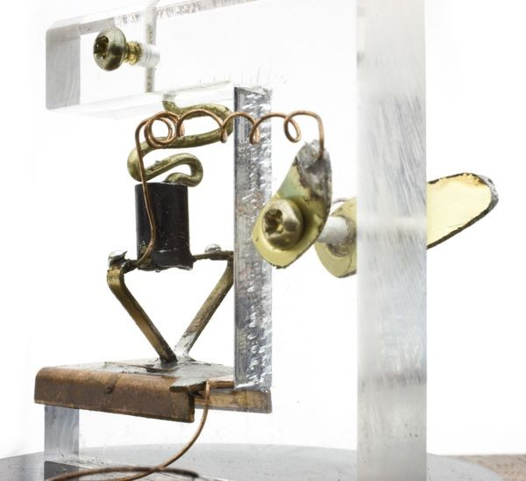
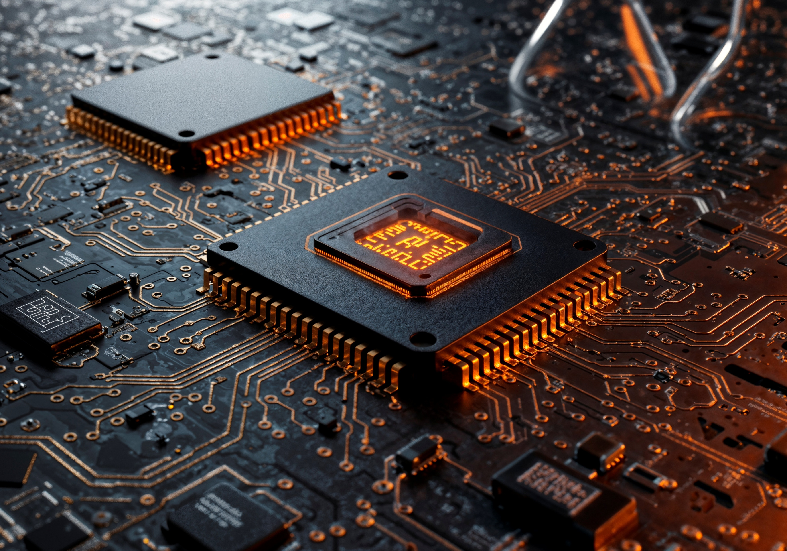
Eureka!
The first-ever transistor.
Bell Labs, 1947
In late June 2026, IBM unveiled the world's first sub-1-nanometer chip technology at the 0.7 nm "nanostack" node, packing nearly 100 billion transistors onto a fingernail-sized chip and extending logic scaling into the angstrom era for AI and high-performance computing.

Slide 3

Eureka!
In late June 2026, IBM unveiled the world's first sub-1-nanometer chip technology at the 0.7 nm "nanostack" node, packing nearly 100 billion transistors onto a fingernail-sized chip and extending logic scaling into the angstrom era for AI and high-performance computing.
The first-ever transistor.
Bell Labs, 1947

Slide 4
Design and Implementation of a ShuffleNet V2 Accelerator on FPGA Using RTL and HLS
XLR8
Graduation Project Discussion | Faculty of Engineering | Menuofia University
Supervised by: Dr. Tamer Fetouh

Slide 5
Presentation Outline
What we will cover today
Act I — Before We Design
Act II — Design and Results
1. Reinventing Fire
6. Design Mapping
2. Problem Statement
7. RTL Architecture
3. Objectives
8. Implementation & FPGA Prototyping
4. Related Work
9. Conclusion and Q&A
5. AI Model Analysis

Slide 6
ACT 1
01
HISTORICAL CONTEXT
From transistors to intelligence — the journey that made this project necessary

Slide 7
ACT 1
VLSI + AI:
60 Years of Convergence
▸ 1958 — Jack Kilby invents the IC: 6 transistors on germanium
▸ Moore's Law (1965): transistor count doubles every ~18 months
▸ 2023 — Apple M3: 19 billion transistors on a single chip
▸ 1957 — Rosenblatt's Perceptron: the first artificial neuron
▸ 2012 — AlexNet wins ImageNet with a GPU: the AI breakthrough moment
▸ Today — AI compute demand grows 10× per year; hardware barely keeps up

Slide 8
ACT 1
02
Problem Statement
Why existing solutions fall short — and what we are solving

Slide 9
ACT 1
The Unfair Advantage
CPU
GPU
AI Accelerator
Design Philosophy: Few powerful cores, optimized for sequential/control-heavy logic.
Perf/Watt: Low for AI workloads.
Fully general-purpose.
Latency: Low for small ops, poor scaling for large parallel ops
Design Philosophy: Thousands of simple cores (SIMD/SIMT), optimized for parallel throughput
Perf/Watt: Moderate-high
General parallel compute (graphics, AI, HPC, crypto)
Latency: Higher per-op latency, but excellent batched throughput
Design Philosophy: Fixed or reconfigurable data path built specifically for tensor/matrix ops.
Perf/Watt: Highest — this is the core value proposition.
Narrow — tuned to specific model/op types
Latency: Very low, deterministic (critical for real-time/edge — e.g., FPGA inference)

Slide 10
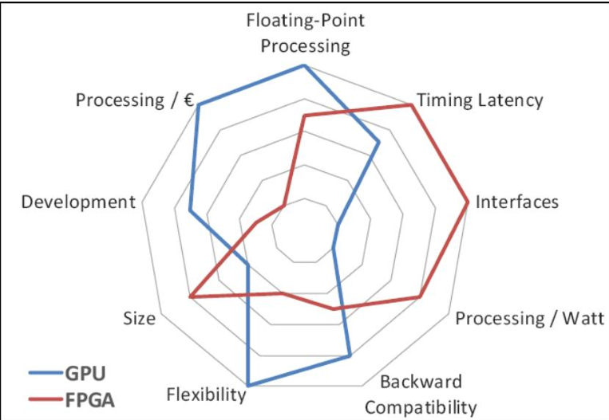
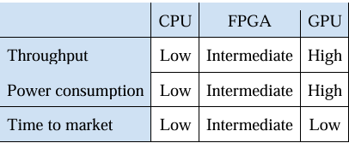
ACT 1
The Unfair Advantage

Slide 11
ACT 1
Why Cloud AI Fails at the Edge?
▸ Latency: 50–500 ms round trip — useless for real-time control or robotics
▸ Privacy: raw video leaves the device and travels the internet
▸ Bandwidth: streaming HD to the cloud consumes significant network resources
▸ Reliability: no connectivity = no AI — fails in tunnels, remote sites, factories
▸ Power: a data-center GPU draws 300 W — impossible on a battery or embedded rail

Slide 12
ACT 1
The Challenge
▸ Real-time image classification at the edge requires < 50 ms latency
▸ ARM Cortex-A53 software inference: hundreds of milliseconds per frame
▸ GPU/cloud solutions: too power-hungry and unavailable at the edge
▸ HLS-generated accelerators: high resource overhead, suboptimal efficiency

Slide 13
ACT 1
03
Solution Objectives
What we set out to prove — and how we will measure success

Slide 14
ACT 1
Our Approach
▸ Hand-crafted RTL Verilog for ShuffleNet V2 × 1.0
▸ Q6.8 fixed-point datapath with per-layer width optimization
▸ All weights stored on-chip (no DDR access during inference)
▸ HLS models for quantitative RTL vs. HLS comparison

Slide 15
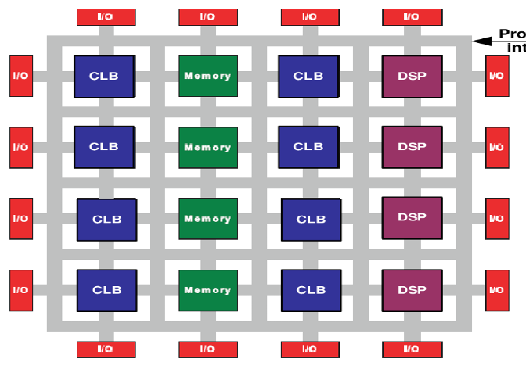
ACT 1
Design a custom RTL accelerator for ShuffleNet V2

Slide 16
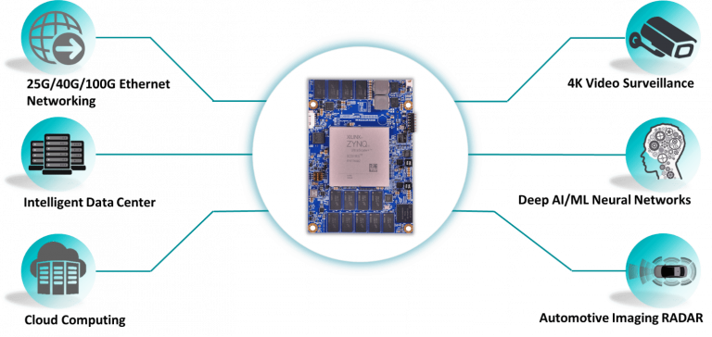
ACT 1
Design a custom RTL accelerator for ShuffleNet V2

Slide 17
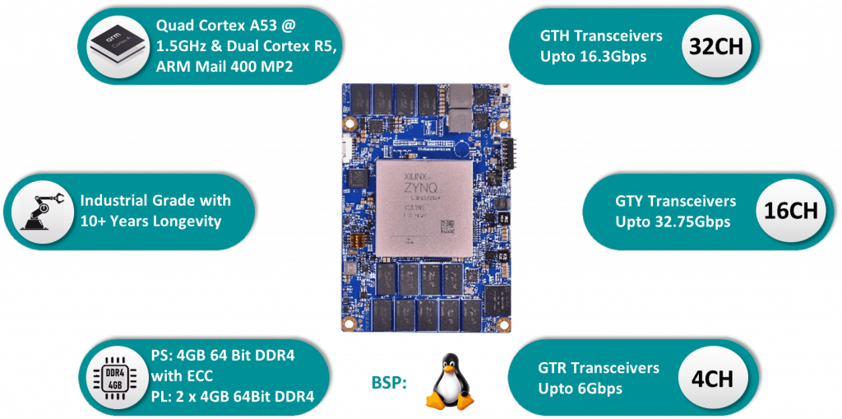
ACT 1
Target Hardware Metrics

Slide 18
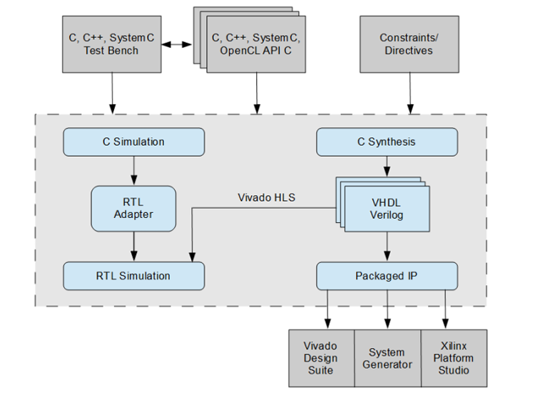
ACT 1
RTL VS HLS:
Before the Battle

Slide 19
ACT 1
RTL VS HLS:
Before the Battle
HLS
Advantages
Faster development
Easier debugging
Faster prototyping
Reusable high-level code
Shorter design cycle
Limitations
Lower hardware efficiency
Higher resource utilization
Less architectural control
Timing optimization is harder
Performance depends on the compiler

Slide 20
ACT 1
RTL VS HLS:
Before the Battle
Hardware resource utilization
Operating frequency and timing
Power and implementation efficiency
Determine the best approach for edge AI deployment.

Slide 21
ACT 1
04
Related Work
What others have built — and where the gaps remain

Slide 22
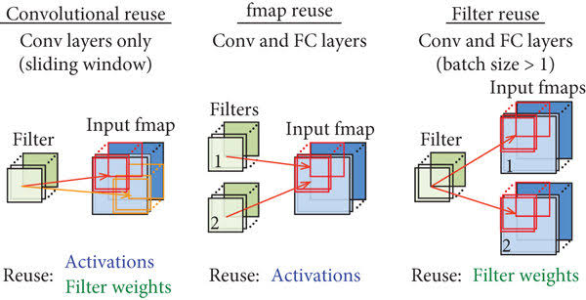
ACT 1
Common FPGA CNN Acceleration Techniques

Slide 23
ACT 1
Architectural Tradeoffs in FPGA CNN Accelerator Design
Throughput vs resource
On-chip buffering
Quantization: reduces bitwidth
Dataflow style
Interface bottleneck
Efficient lightweight accelerators remain an active research area.

Slide 24
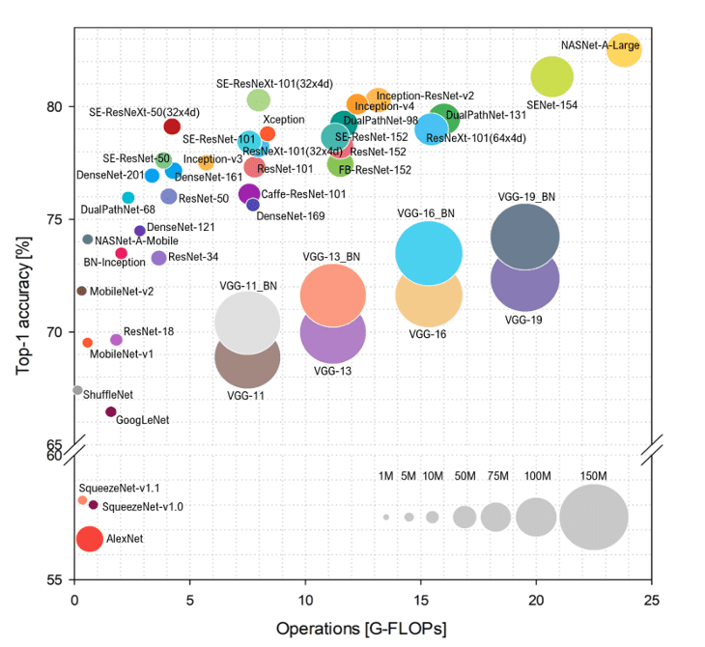
ACT 1
Why lightweight CNN models?
Traditional CNNs require extensive computation and high memory usage. Mobile devices demand energy-efficient inference.
Lightweight CNNs reduce computation significantly and maintain competitive accuracy with fewer resources.

Slide 25
ACT 1
ShuffleNet V2
ShuffleNet V2:
Designed specifically for efficient mobile inference.
Uses channel split and channel shuffle.
Reduces memory access cost.
Balances accuracy and computational efficiency.
Suitable for FPGA and edge AI deployment.

Slide 26
ACT 1
Research Gap Analysis
FPGA CNN accelerators
Focus on performance only
HLS implementations
Limited hardware optimization
“Most research evaluates only one methodology”
RTL implementations
Longer development time
Lightweight CNN studies
Rare RTL–HLS comparison
This project closes all four gaps simultaneously

Slide 27
ACT 1
Prior Work VS Our Contribution
 | MobileNet FPGA | HLS Only | ShuffleNet Prior | Our Work
Model | MobileNet V2 | Various | ShuffleNet V1 & V2 | ShuffleNet V2
Methodology | RTL or HLS | HLS Only | HLS Only | RTL + HLS
Channel Shuffle HW | N/A | Partial | Omitted | Full RTL
DW Conv | Optimized | Partial | Tool-Managed | Limited Hand-Optimized
Dynamic Quantization | Static Only | Static Only | Limited | Per-Layer Dynamic

Slide 28
ACT 1
05
AI Model Analysis
Understanding the neural network before building the hardware

Slide 29
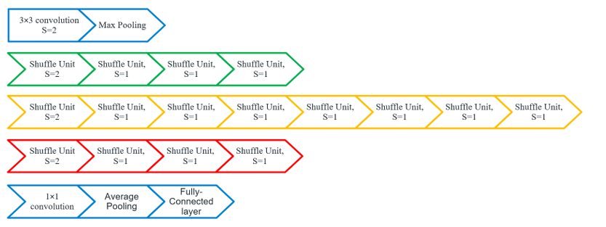
ACT 1
ShuffleNet V2 Architecture

Slide 30
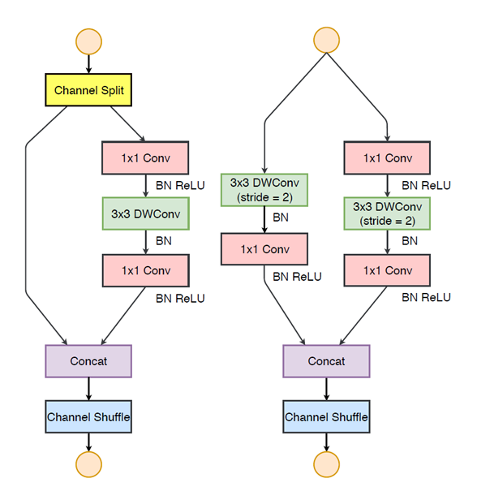
ACT 1
ShuffleNet V2 building block

Slide 31
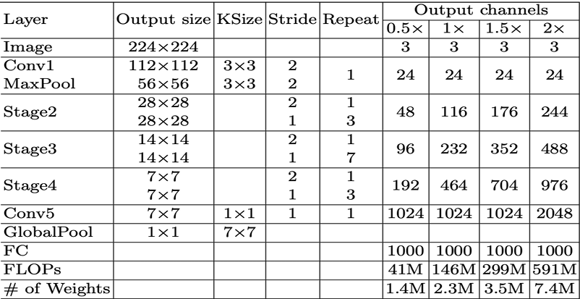
ACT 1
ShuffleNet V2 computational structure

Slide 32
ACT 1
Software model development
Pretrained PyTorch Model
BN Folding
Verification on ILSVRC
Quantization
Export (weights, config tables, bitwidth CSV)

Slide 33
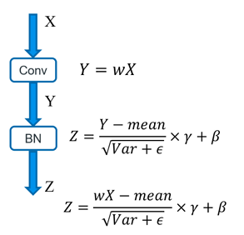
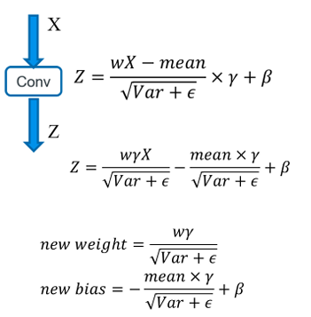
ACT 1
Batch Normalization Folding
Before
After

Slide 34
ACT 1
Why quantization?
Quantization:
Quantization converts values to fixed-point.
Reduces memory and computation cost.
Improves FPGA resource efficiency.
Enables faster real-time inference.

Slide 35
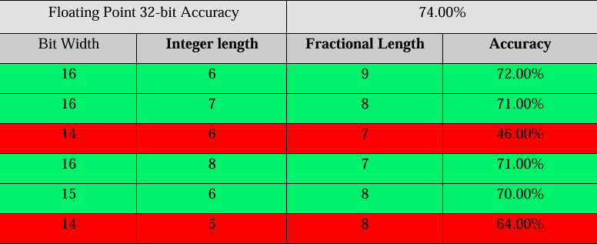
ACT 1
Dynamic fixed-point Quantization

Slide 36
ACT 1
Benefits
Reduced arithmetic complexity.
Higher processing throughput.
Lower power consumption.
Efficient edge AI deployment.

Slide 37
ACT 2
06
DESIGN MAPPING
Translating math into circuits — the bridge between model and hardware

Slide 38
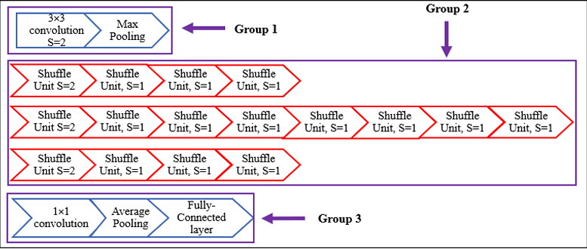
ACT 2
The Bridge: From SW to HW

Slide 39
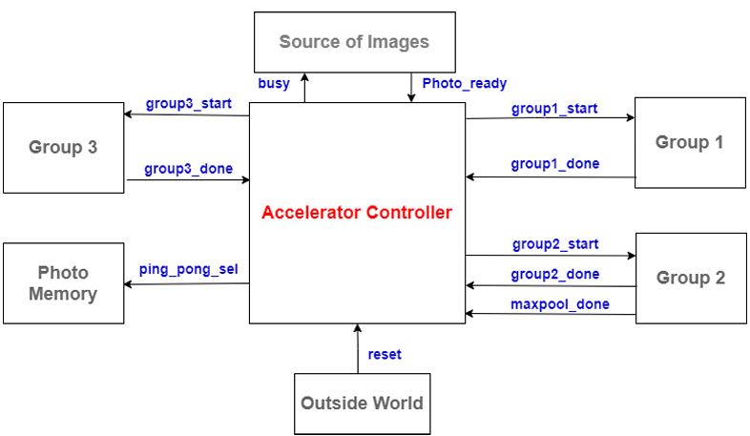
ACT 2
Input/ Output Interfaces

Slide 40
ACT 2
Key Design Decisions
▸ Q6.8 fixed-point: 15-bit signed, per-layer width optimization
Group 1 Conv
8-bit (pixels)
12-bit
▸ Group 2: 58-filter DW + 12-parallel PW over 16 accumulation steps
Group 2 DW
10-bit
15-bit
▸ Internal 58×784-word dist. RAM buffer between DW and PW phases
Group 2 PW
12-bit
11-bit
▸ Group 3: full-precision 27-bit PW output, bypasses quantizer
Group 3 PW
12-bit
9-bit
▸ BN parameters folded offline using PyTorch — no run-time normalization
Group 3 FC
9-bit
9-bit

Slide 41
ACT 2
07
RTL ARCHITECTURE
50 modules. 48 testbenches. One accelerator.

Slide 42
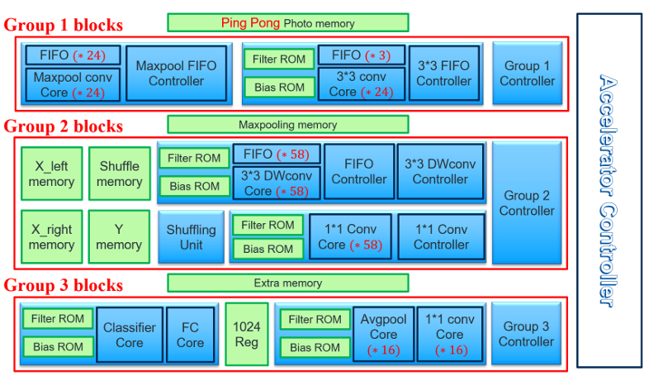
ACT 2
Top-Level System Architecture

Slide 43
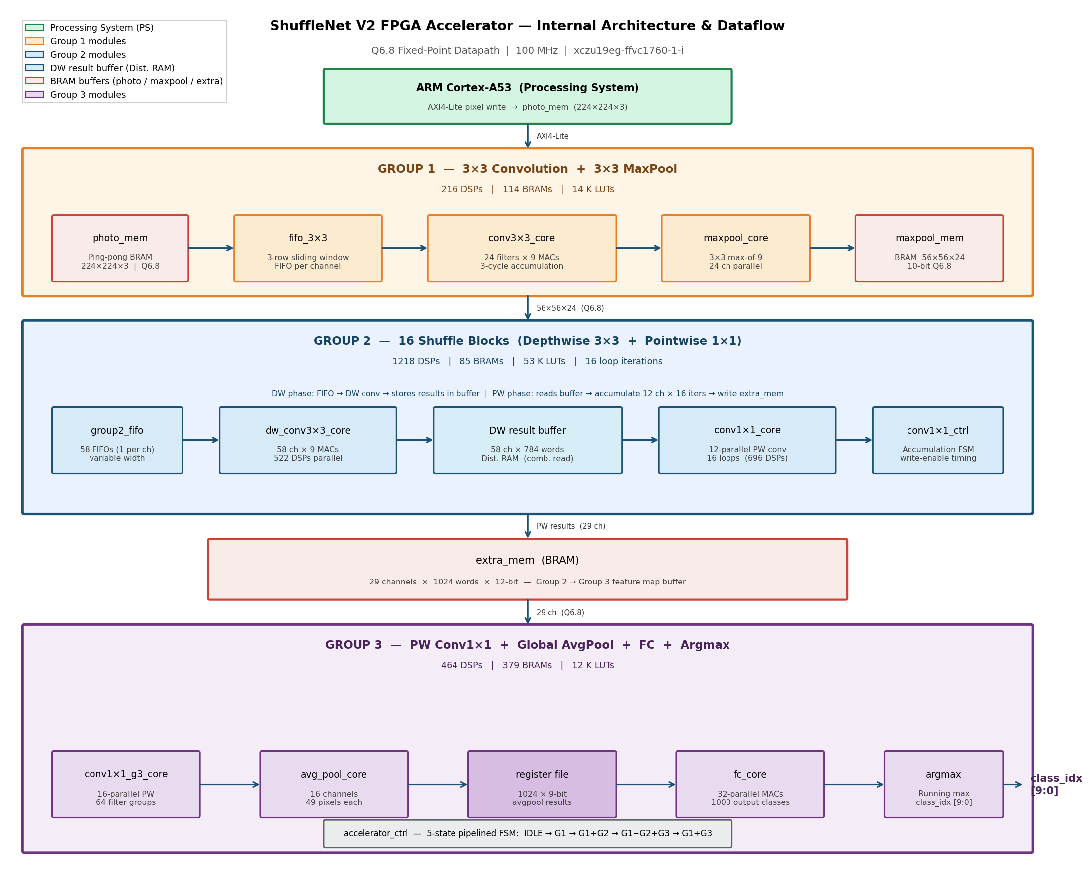
ACT 2
Internal Architecture & Dataflow

Slide 44
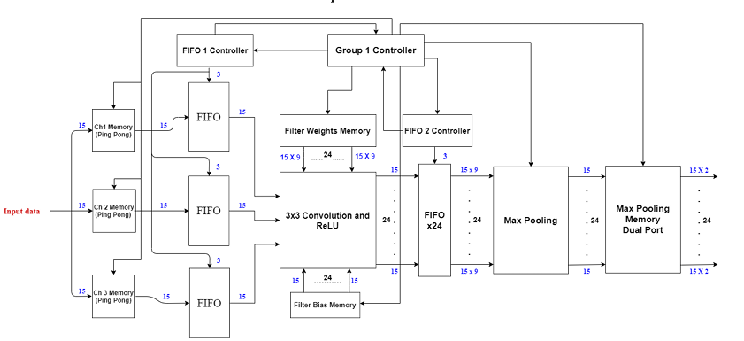
ACT 2
Group 1: The Initializer

Slide 45
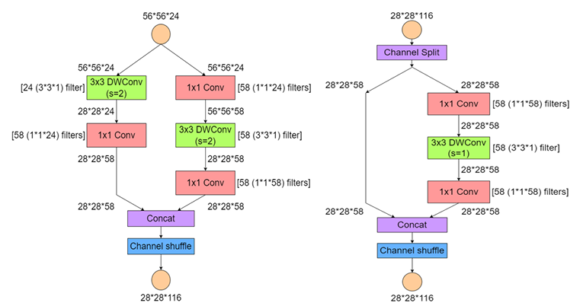
ACT 2
Group 2: Where All Work Happens

Slide 46
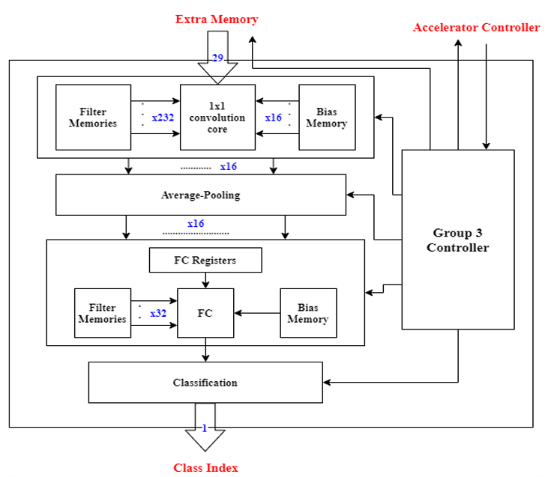
ACT 2
Group 3: The Final Result is Here

Slide 47
ACT 2
The Combined Flow
Group 1
Group 2
Group 3
3×3 Conv + MaxPool
16 Shuffle Blocks
PW + AvgPool + FC + Argmax
→
→
224×224×3 → 56×56×24
56×56×24 → 7×7×464
7×7×464 → class_idx
24 DSPs 216 total
58 filters 1218 DSPs
16+32 parallel 464 DSPs

Slide 48
ACT 2
Group 3: The Final Results are Here
Common Primitives
Group 1
Group 2
Group 3
Mem + AXI + Top Level
9
10
14
11
4
modules
modules
modules
modules
modules
mac_unit, adder_trees, quantizer, FIFOs
conv3x3, maxpool, photo_mem, ROMs, ctrl
DW, PW, FIFOs, ROMs, ctrl, top
PW, avgpool, FC, ROMs, ctrl, top
extra_mem, AXI slave, accel_ctrl, accel_top
✓ 48 / 48 TESTBENCHES PASS — Zero failures
▸ Self-contained: no external hex vector files required
▸ Q6.8 Python model: ~71% Top-1 on 100 ImageNet validation images
▸ BN-fold coefficient error: 7.63×10⁻⁶ (within tolerance)

Slide 49
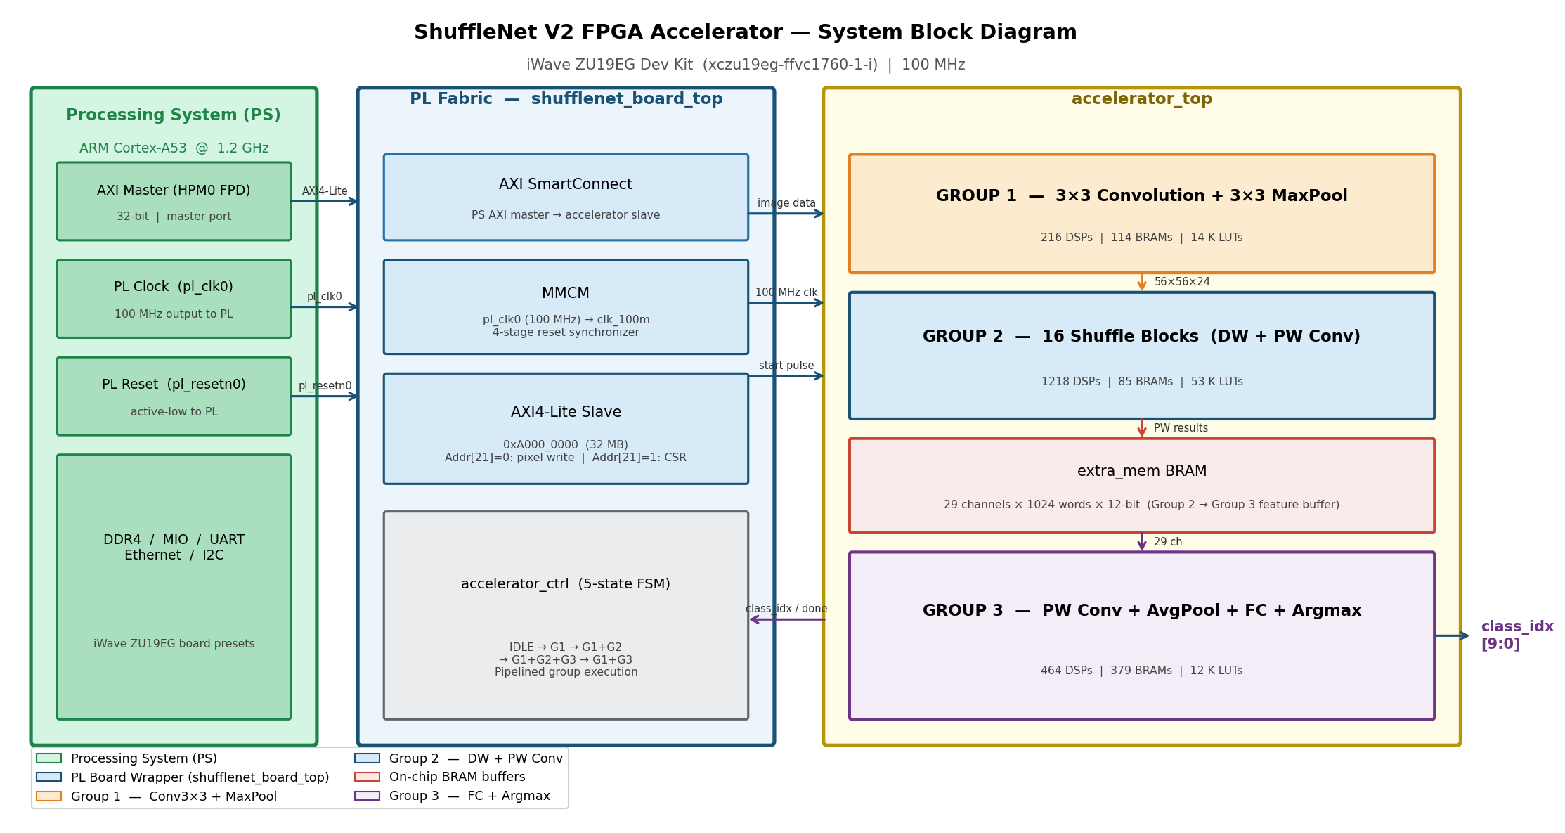
ACT 2
FPGA Integration

Slide 50
ACT 2
08
IMPLEMENTATION &
FPGA PROTOTYPING
Seeing is believing — the accelerator in action

Slide 51
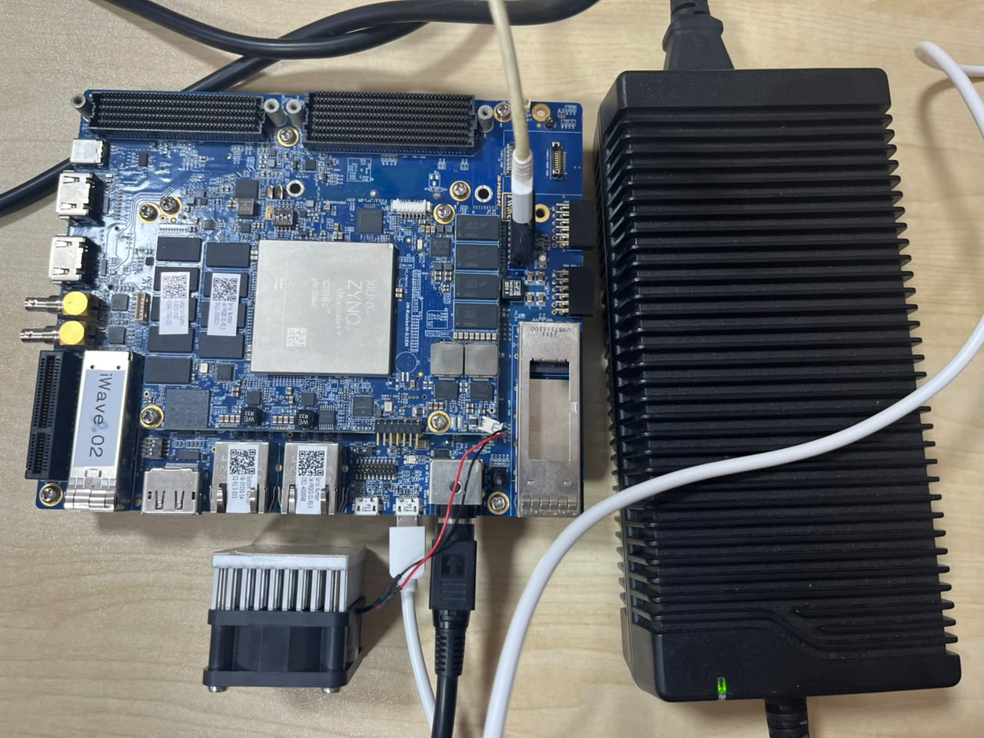
ACT 2
The $5K Baby

Slide 52

ACT 2
The Work Moment

Slide 53
ACT 2
The Test: The Moment of Truth

Slide 54
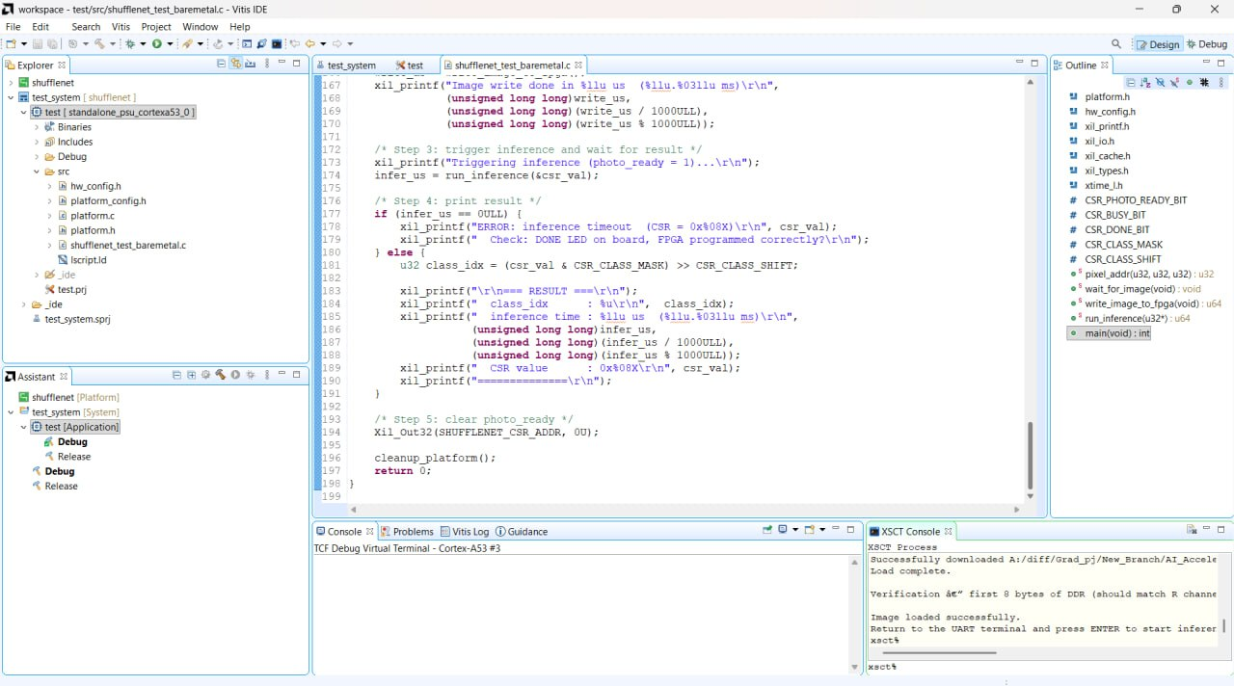
ACT 2
The Code Compiled Successfully

Slide 55
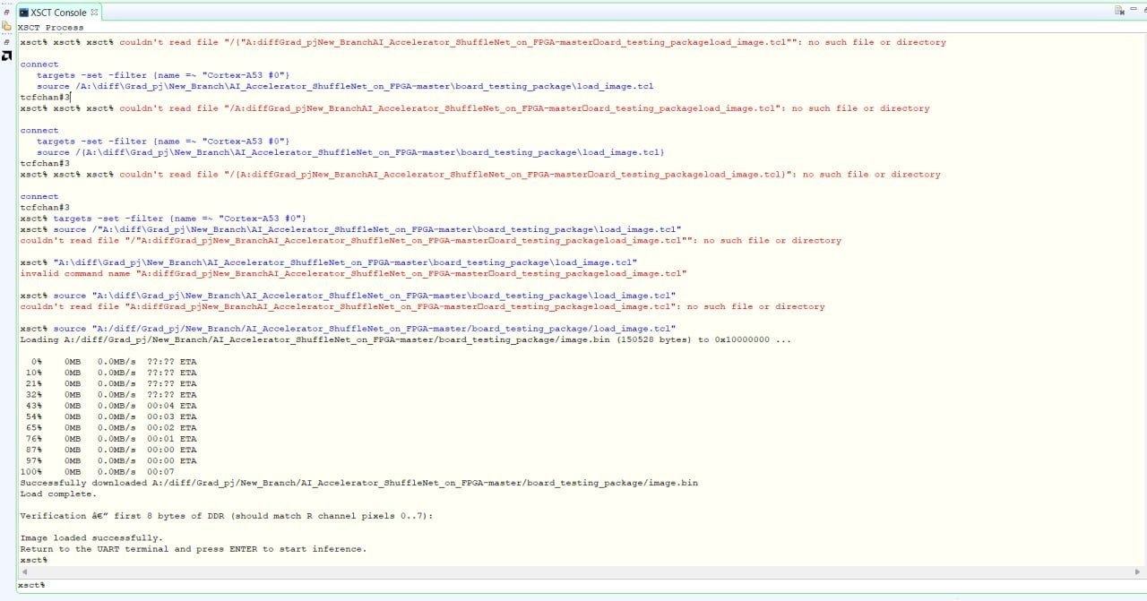
ACT 2
The Code Compiled Successfully

Slide 56
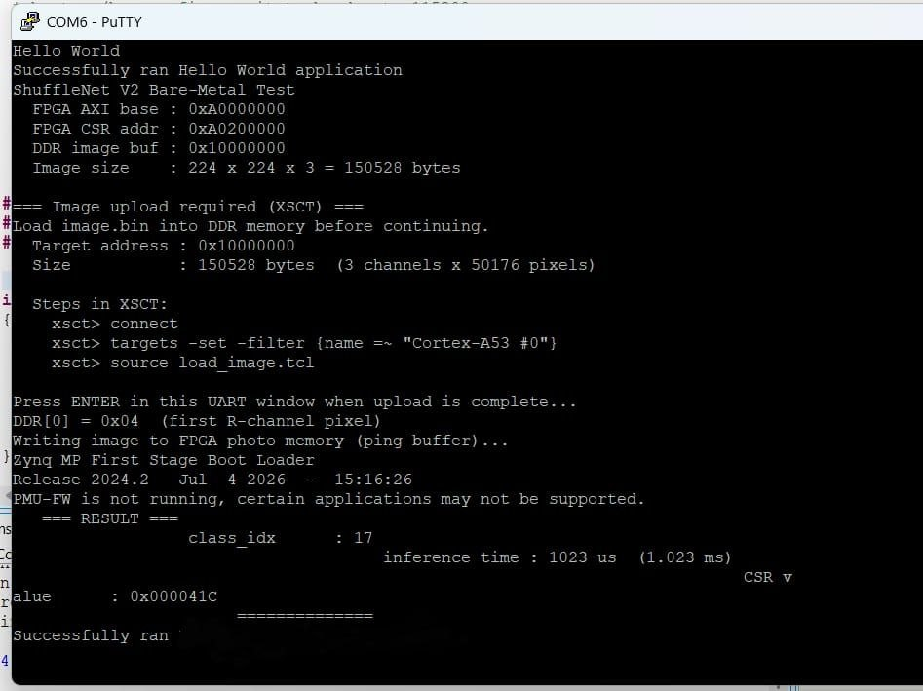
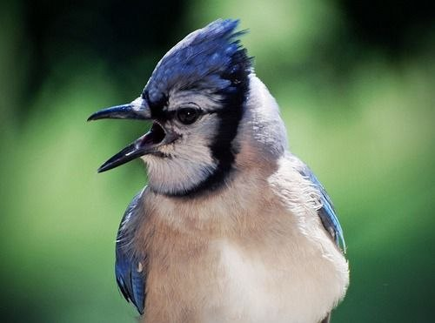
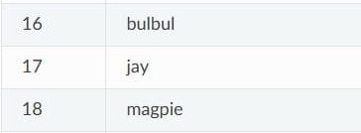
ACT 2
The Code Compiled Successfully

Slide 57
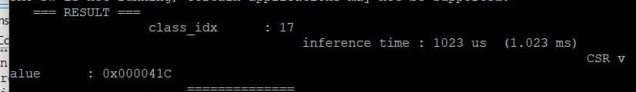
ACT 2
The Code Compiled Successfully

Slide 58
ACT 2
Implementation Results
100 MHz
+0.096 ns
78.76%
58.69%
14.34%
Target Clock
WNS (Timing Closed)
DSP Utilization
BRAM Utilization
LUT Utilization
Resource Summary
Resource
Used
Available
Utilization
DSP48E2
1,550
1,968
78.76%
BRAM Tile
550.5
984
55.95%
LUT
68,299
522,720
13.07%
Flip-Flop
15,285
1,045,440
1.46%
✓ Timing closed at 100 MHz | WNS = +0.096 ns | WHS = +0.011 ns | 0 failing endpoints
Board-level performance (fps, latency, power) pending hardware deployment

Slide 59
ACT 2
The HLS Methodology
Model 1 Baseline
Model 2 Pipelined
Model 3 Parallelism
Model 4 Final
Sequential No directives
#pragma HLS PIPELINE
UNROLL factor 16/32 + PARTITION
Pipeline + Parallelism + 7 ns
Key: Reference
Key: Pipelining
Key: Parallelism
Key: Combined

Slide 60
ACT 2
RTL VS HLS: The Battle Results
Metric | HLS | RTL
Top-1 Accuracy | 71% | 71%
Fits on the target chip? | No — needs 257–337% of available DSP/BRAM (over capacity, would not fit as generated) | Yes — fits comfortably: 79% DSP, 59% BRAM
Power draw | Not measurable as generated — design is too large to implement | 6.816 W (real, measured)
Energy per image | Not measurable as generated | 0.0053 J (real, measured)

Slide 61
ACT 2
09
CONCLUSION
Objectives met. Contributions made. What comes next?

Slide 62
ACT 2
What We Delivered?
▸ Complete RTL implementation of ShuffleNet V2 — timing closed at 100 MHz
▸ 48 RTL modules, 48 self-checking testbenches — all pass
▸ Q6.8 fixed-point model: ~71% Top-1 accuracy on ImageNet
▸ Four Vitis HLS models for RTL vs HLS comparison on ZU19EG
▸ Program ZU19EG and run end-to-end inference test
▸ Measurement of throughput, latency, and on-chip power
▸ Run HLS models and compile RTL vs HLS table
▸ Full documentation: README, block diagrams, reports

Slide 63
ACT 2
Key Achievement
Fully custom RTL ShuffleNet V2 accelerator synthesized and timing-closed on ZU19EG at 100 MHz DSP: 78.76% | BRAM: 58.69% | LUT: 14.34% | WNS: +0.096 ns

Slide 64
ACT 2
What’s Next?
Keep developing the architecture to meet higher standards and get better results.
Track all the related work of people implementing the same project with different metrics.
Publish a scientific paper and join academic competitions.
Seek higher and more complex models to implement.

Slide 65
ACT 2
Q/A
We are ready to defend our cause.

Slide 66
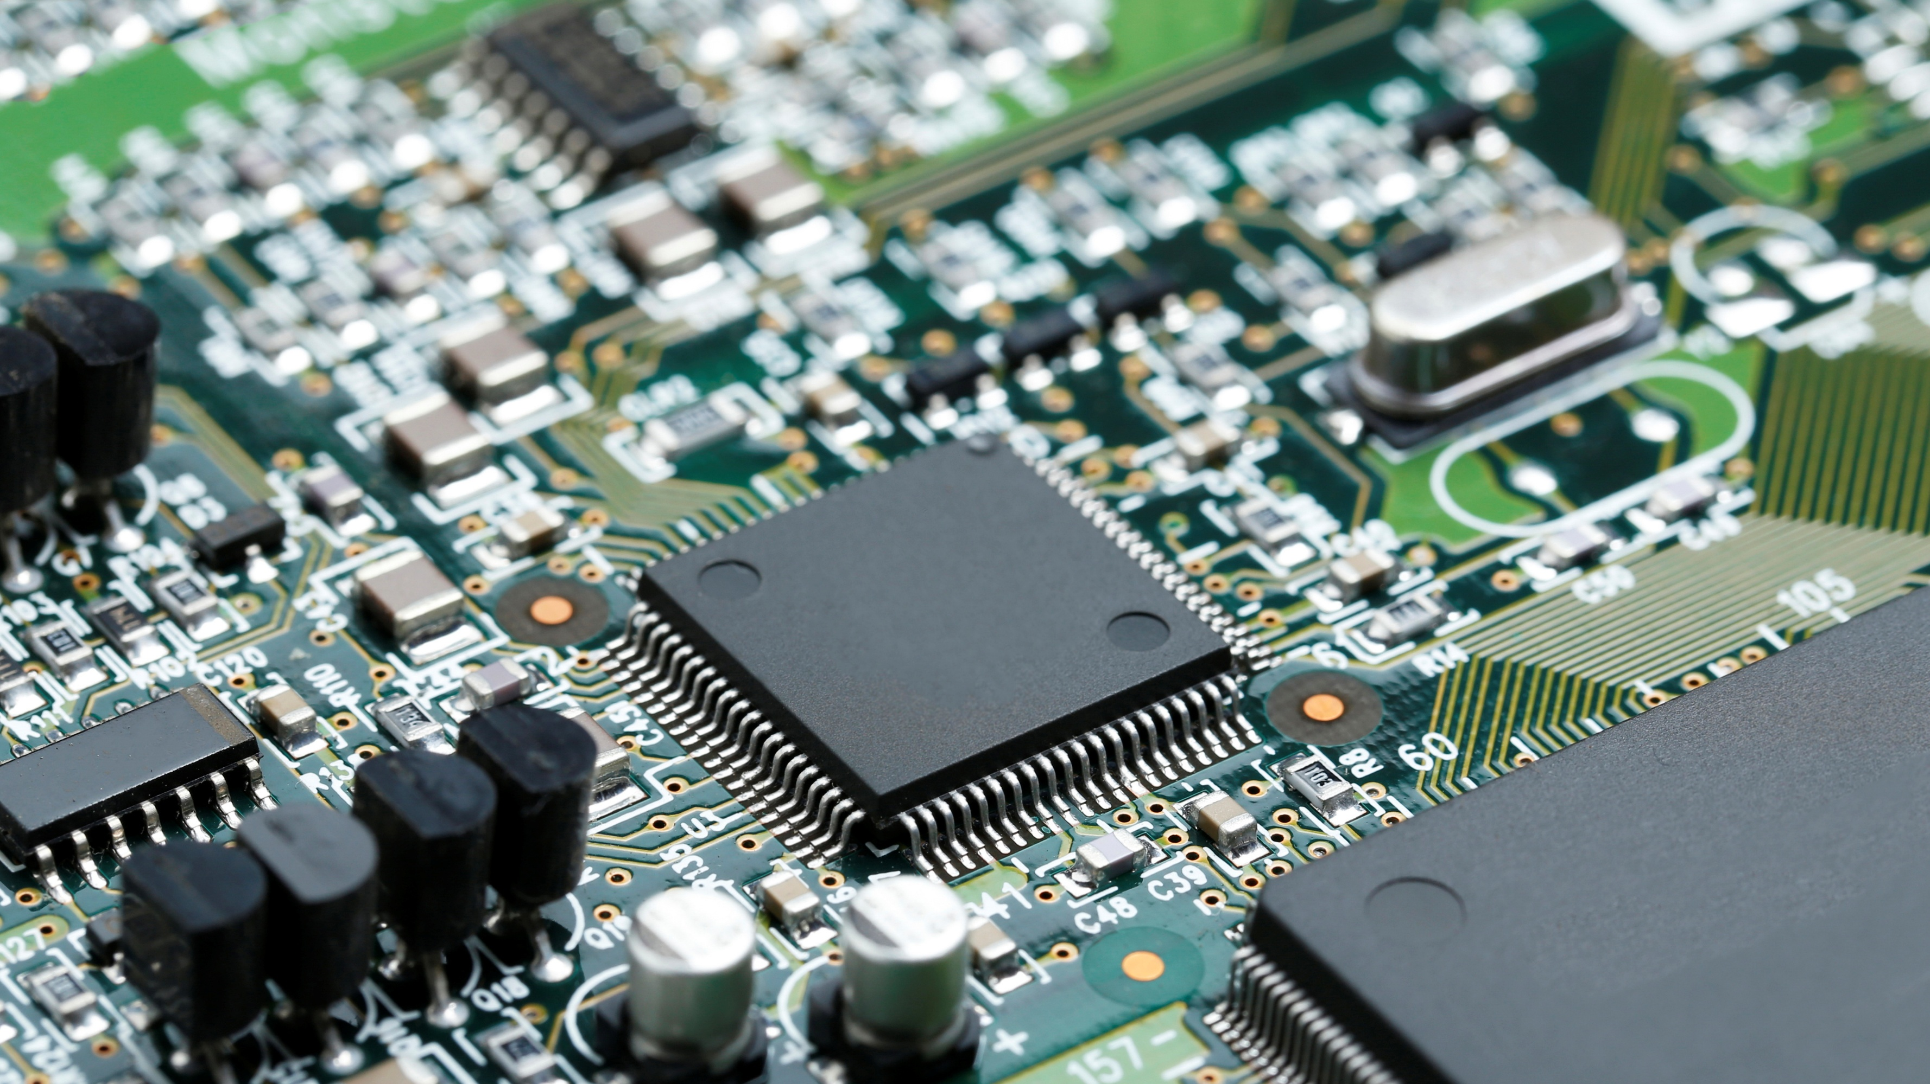
Thanks for your Time

